Slide 1


CPU
Haijian Sun
Email: sunh@uww.edu

Slide 2
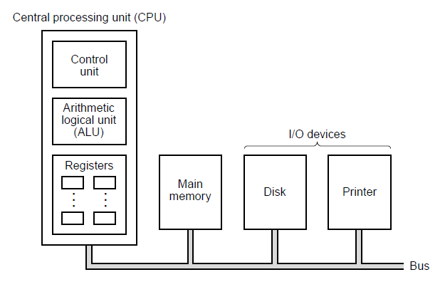
Learning Object (CU)
The organization of a simple computer with one CPU and two I/O devices.
Notes:
So far, we show the history of computer.

Slide 3
Control Unit (CU)
One of major Component of CPU
Direct the operation of the processor
How to respond to a program’s instructions among memory, arithmetic/logic unit, input/output device
Handles all processors control signals
Most computer resources are managed by the CU.
CU directs the flow of data between the CPU and the other devices.
Notes:
The control unit (CU) is a component of a computer's central processing unit (CPU) that directs the operation of the processor.
It tells the computer's memory, arithmetic/logic unit and input and output devices how to respond to a program’s instructions

Slide 4
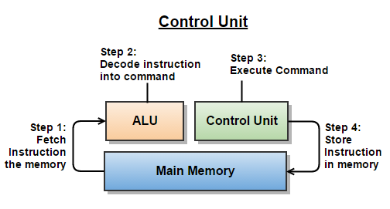
Control Unit (CU)
Functions of Control Unit
Main function is “send and receive control signals” from the other devices and handle related task such as fetching, decoding, execution of the instruction and store result.
(Cache, Registers)
Notes:
Control Unit make an order to Main memory about fetch instruction.
Fetching the Instructions: The control unit fetches an instruction from the memory with the help of registers. An instruction to be executed is stored in one of the Computer Registers.
Decoding the Instructions: After fetching the instruction into a register, the control unit decodes the instruction with the help of a decoder so that the CPU can understand what operation is to be performed.
Executing the Instructions: The decoded instruction is then executed by the CPU and the results are stored in the registers.
ALU receive the right instruction via CU. and decode the instruction.
And CU excute the command and store the result in cache.
Now, we know about what is CU that is for control instruction and you already have known the main memory (Cache) that is for store the data and program

Slide 5
Learning Object (ALU)
The organization of a simple computer with one CPU and two I/O devices.

Slide 6
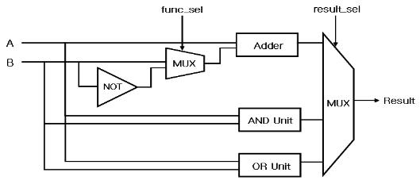
Arithmetic Logical Unit (ALU)
ALU is one of the essential part of CPU
Perform computation on operands, computation kind of arithmetic and logic operation
Use logic circuit such as Adder, Multiplexer (MUX), AND Unit, OR Unit for Arithmetic Unit compromises and Logical Unit compromises

Slide 7
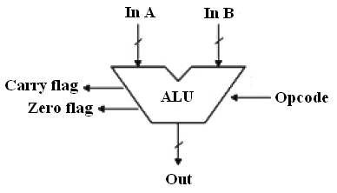
Block of ALU
ALU block
An accumulator is a register for short-term, intermediate storage of arithmetic and logic data in a computer's CPU (central processing unit)
Time and Control
Synchronize microprocessor operations as per clock pulse
Get operands from register
Accumulator
Register section
(Memory)
Control input
Time and Control
ALU Block Diagram
Notes:
So, What is the ALU?
The heart of every computer is an Arithmetic Logic Unit (ALU)
Time and Control Section
Purpose of this unit is to synchronize microprocessor operations as per the clock pulse and to generate the control signals that are necessary for smooth communication between microprocessors and peripherals devices.
The synchronizing pulses on data bus RD and WR bar indicates that data is available or not. The purpose of control unit is to control of data between microprocessors and peripheral devices.

Slide 8
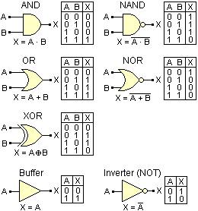
Arithmetic and Logical Unit
Functions of ALU
The Arithmetic Unit compromises
Addition, Subtraction, Multiplication
The Logical Unit compromises
Bitwise AND
Bitwise OR
Bitwise NAND
Bitwise NOR
Bitwise XOR

Slide 9
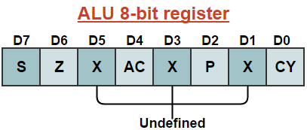
ALU (Accumulator)
8-bit register
Store 8 bit data and performing arithmetic and logic operation
The result of operation stored in accumulator
Five flags
Used to store and transfer the data from the registers by using instructions
Sign flag, Zero flag
Auxiliary Carry flag
Carry flag
Notes:
Flags: Flags are programmable that are used to store and transfer the data from the registers by using instructions. ALU use flip-flops that are used in two states either set and reset which is according to data condition in accumulator and other registers.
S (sign) flag: if the D7 bit is set to be 1 then sign flag is set. Basically it is used to signed numbers
Z (Zero) flag: This flag is set when ALU result is 0.
AC (Auxiliary Carry) flag: In arithmetic operation when carry is generated then it passed to next digit then AC flag is set.
P (Parity) flag: After the ALU operation when result has even number of 1’s the parity flag is set and if it has odd numbers then flag is reset.
C (Carry) flag: this flag is set when arithmetic result is in a carry, otherwise the flag is reset.

Slide 10
Learning Object (Registers)
The organization of a simple computer with one CPU and two I/O devices.

Slide 11
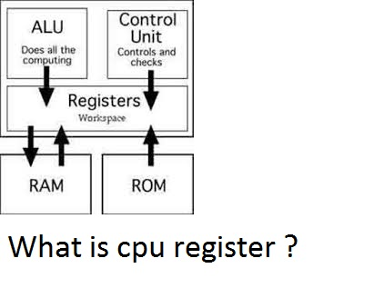
Register
Tiny storage units on CPU
Temporarily storage to prevent bottlenecks between memory and CPU
Store the register
Fetching the instructions
Decoding the Instructions
Executing the instructions
Fastest in Memory
Notes:
Operations performed by the register
Fetching the Instructions: The control unit fetches an instruction from the memory with the help of registers. An instruction to be executed is stored in one of the Computer Registers.
Decoding the Instructions: After fetching the instruction into a register, the control unit decodes the instruction with the help of a decoder so that the CPU can understand what operation is to be performed.
Executing the Instructions: The decoded instruction is then executed by the CPU and the results are stored in the registers.

Slide 12
Summary
Three Components of CPU
Control Unit
Send and receive control signals
Resource Manage
Arithmetic Logical Unit (ALU)
Accumulator
Time and Control for Synchronize Clock
Register
Store the data or program
Result, Input value, Output Value

